Slide 1
Java Memory Management

Slide 2
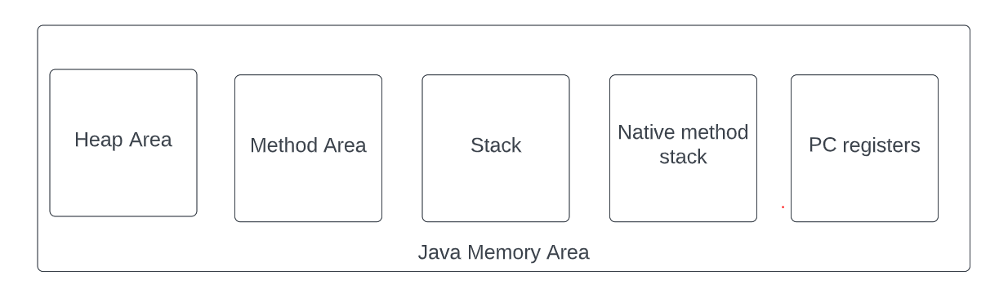
Java Memory Area

Slide 3
Heap Area
It is used to store Objects.
Default size is 1GB.
Change the size of Heap
-Xms<size> set initial Java heap size
-Xmx<size> set maximum Java heap size

Slide 4
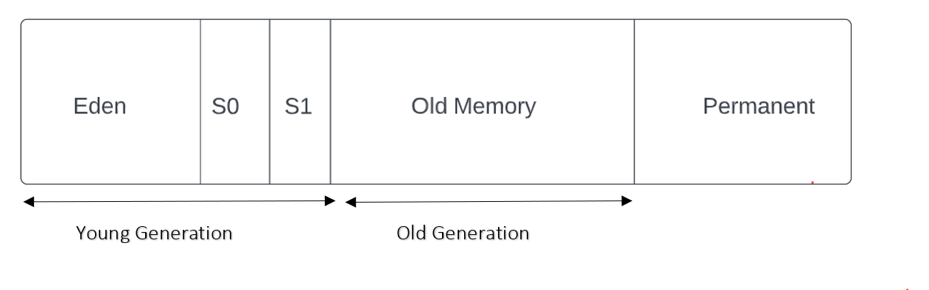
Heap Area

Slide 5
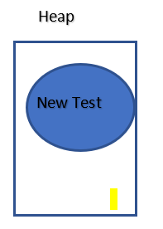

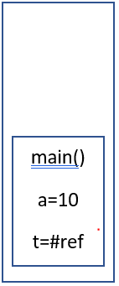
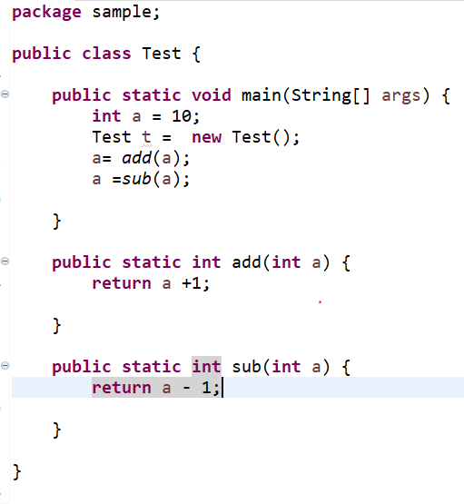
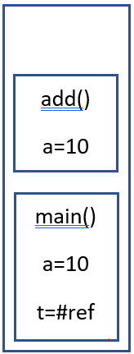
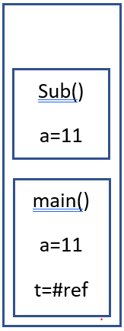
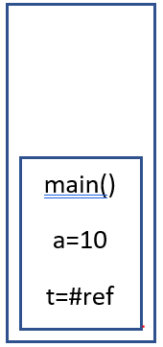
Java Example Stack
Stack

Slide 6
Stack
One for each Thread
Native Method Stack
This is used for native Methods
One for each Thres

